Slide 1

Digital Sales Aid Image Asset Specification
http://bit.ly/dsachat
Marc Benioff
Chairman & CEO

Slide 2
Contents
Image Asset Specifications
DSA App Screens
DSA Salesforce Configuration Screens

Slide 3
Graphical Checklist
APP IMAGES (in app build) | MAIN SCREEN (in Salesforce DSA config) | CATEGORY BACKGROUND (in Salesforce DSA config) | SUBCATEGORY ICON
App Initialization iPad3 2048 x 1496 landscape 1536 x 2008 portrait iPad2 1024 x 748 landscape 768 x 1004 portrait | Background iPad3 2048 x 1224 landscape 1536 x 1736 portrait iPad2 1024 x 612 landscape 768 x 868 portrait Buttons Large Enough to cover the Text | iPad3 1624 x 1224 landscape 1536 x 1246 portrait iPad2 812 x 612 landscape 768 x 623 portrait | 272 x 272 iPad3 136 x 136 iPad2
Bottom Menu Logo 300 x 58 iPad3 150 x 29 iPad2 | Top Menu Logo 300 x 58 iPad3 150 x 29 | Per category. | Per subcategory
App Icon 144 x 144 iPad3 72 x 72 iPad2

Slide 4
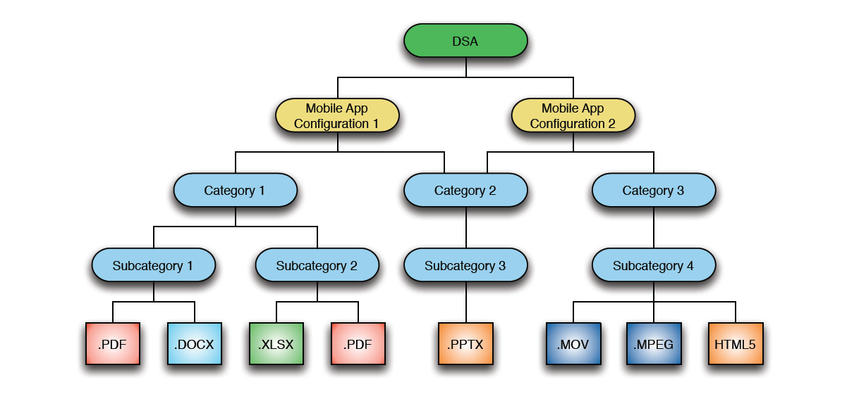
Content Hierarchy

Slide 5
DSA App on iPad

Slide 6
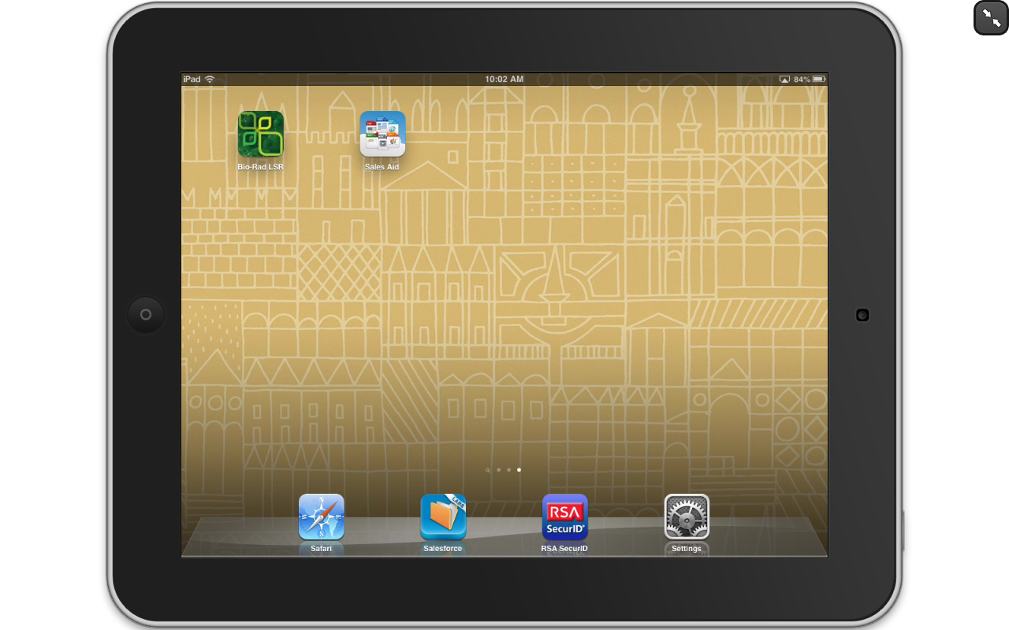
App Name + App Icon

Slide 7
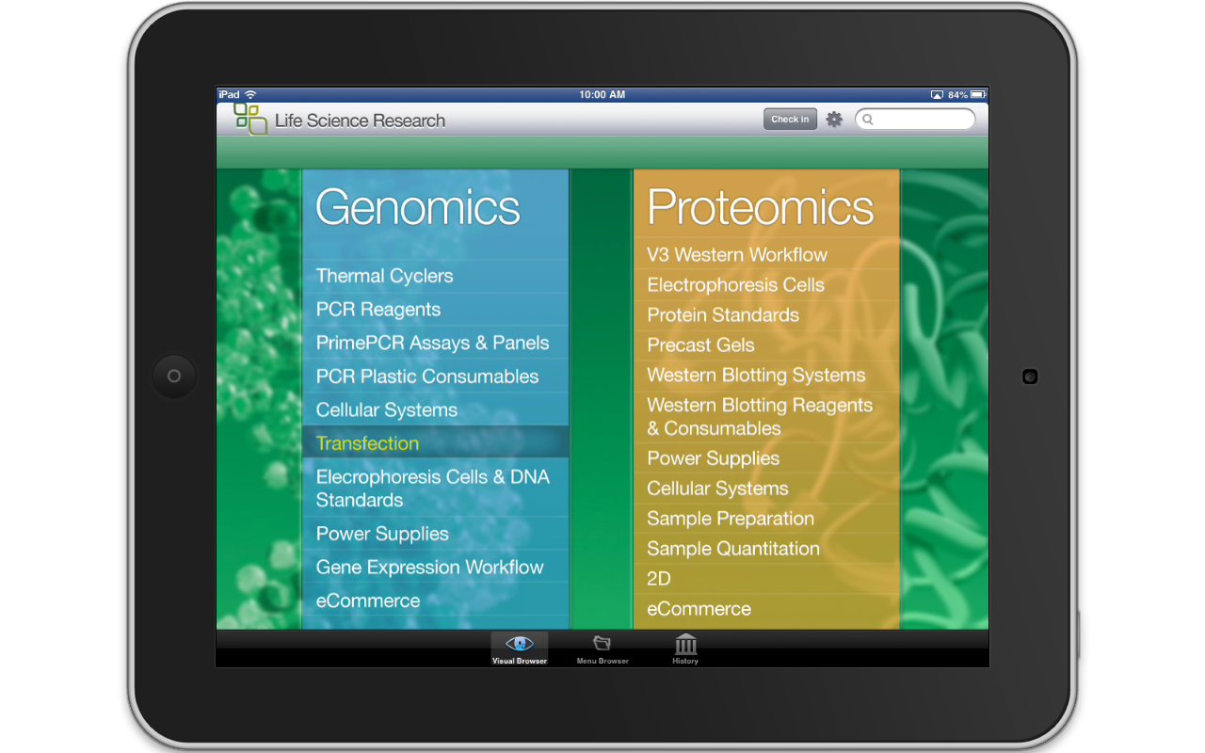
Main Screen Background and Logos

Slide 8
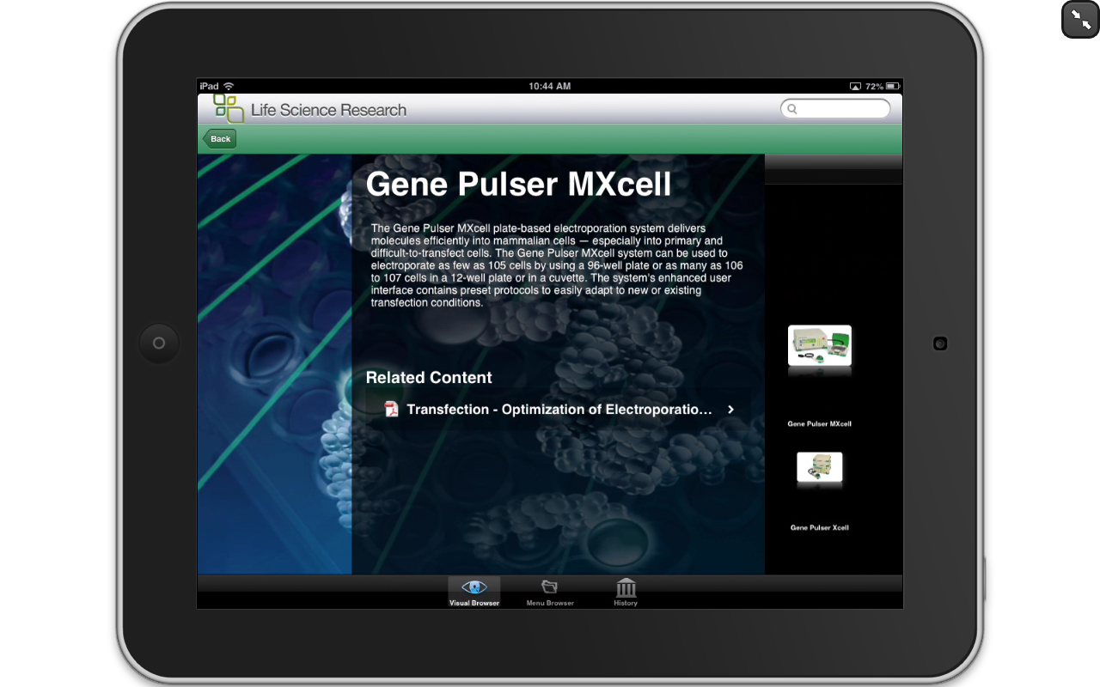
Category Background and Subcategory Icons

Slide 9
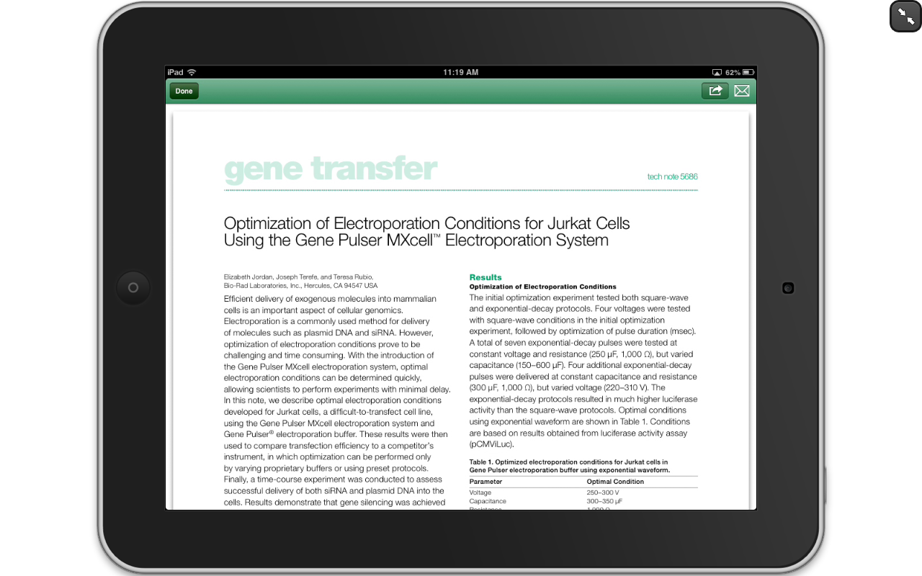
Content Item Viewer

Slide 10
Image Asset Locations

Slide 11
App Name + App Icon

Slide 12
Main Screen Background and Logos
Top Menu Logo
Title Bar
Main
Background
Bottom Menu Logo

Slide 13
Category Background and Subcategory Icons
Main Button
Category Background
Subcategory
Gallery
Icon
Content List Bar

Slide 14
Configurable Colors (partial list)
App Title Bar
App Title Text
Main Button
Main Button Text
Category Title
Content List Bar Background
Content List Bar Selected

Slide 15
Salesforce DSA Configuration

Slide 16
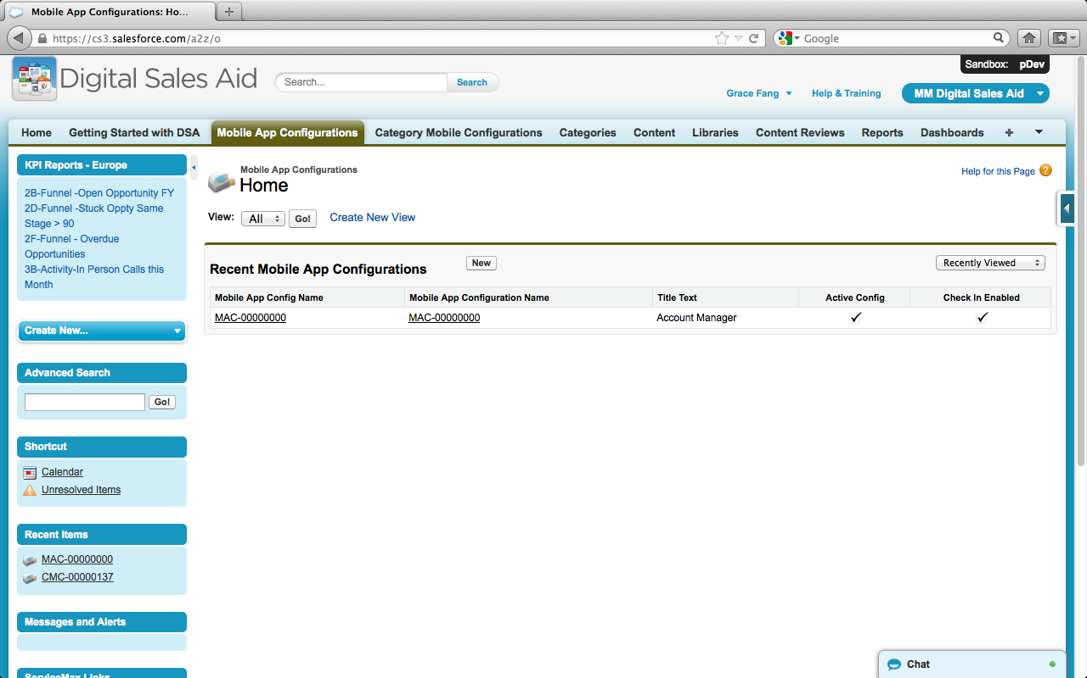
Salesforce DSA App Package

Slide 17
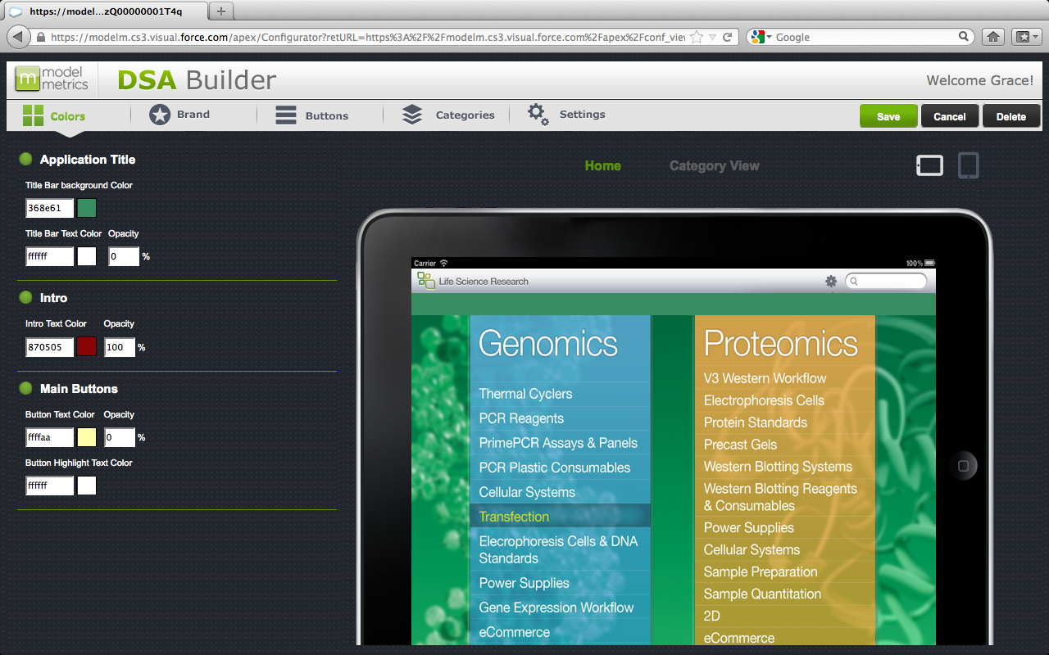
DSA Configuration: Colors Tab

Slide 18
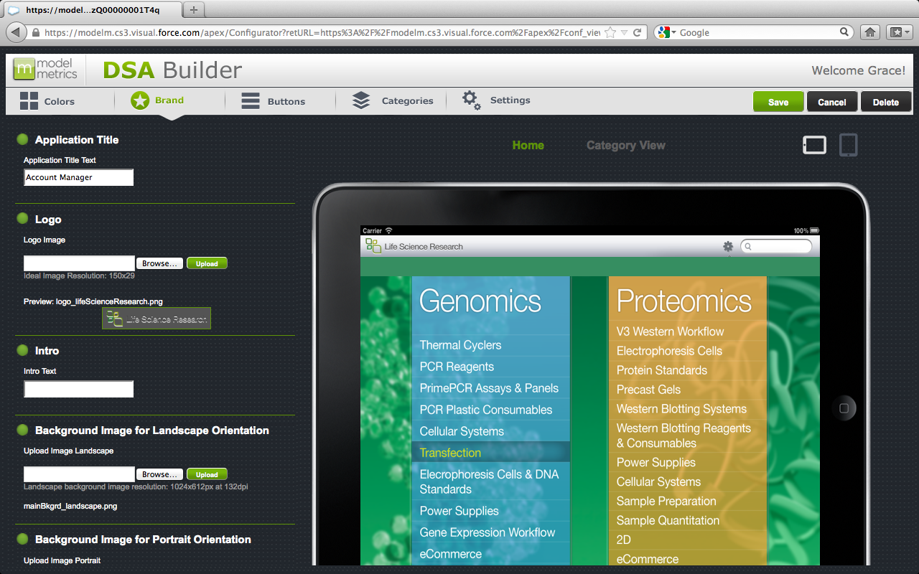
DSA Configuration: Brand Tab

Slide 19
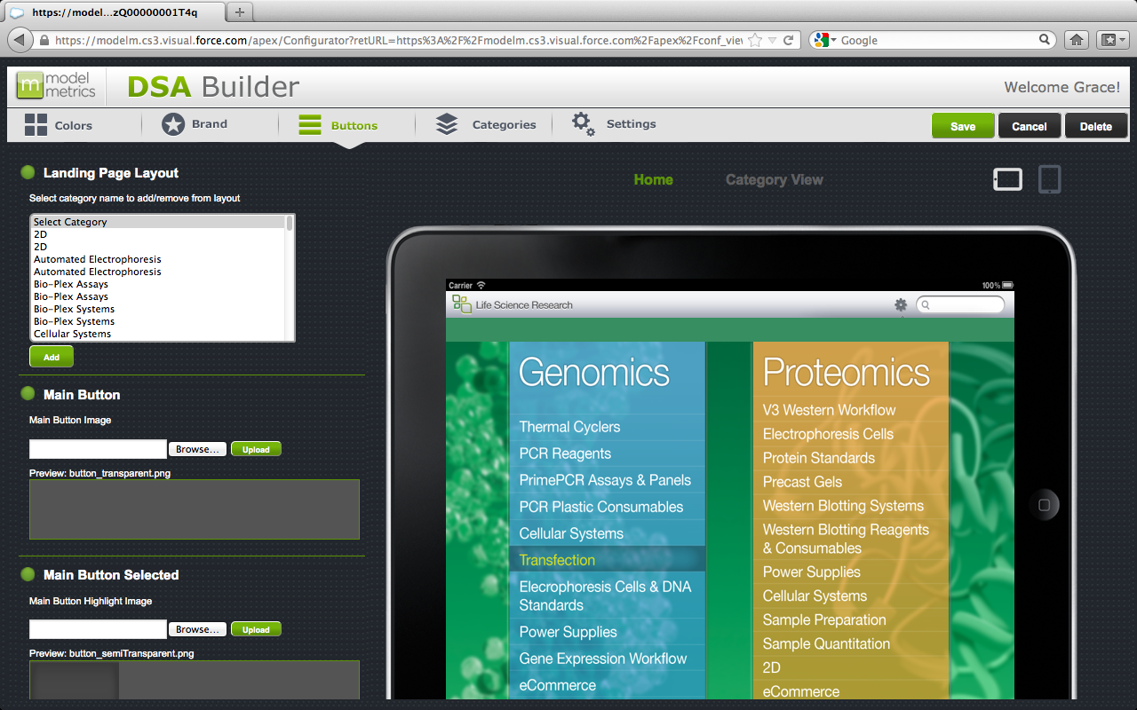
DSA Configuration: Buttons Tab

Slide 20
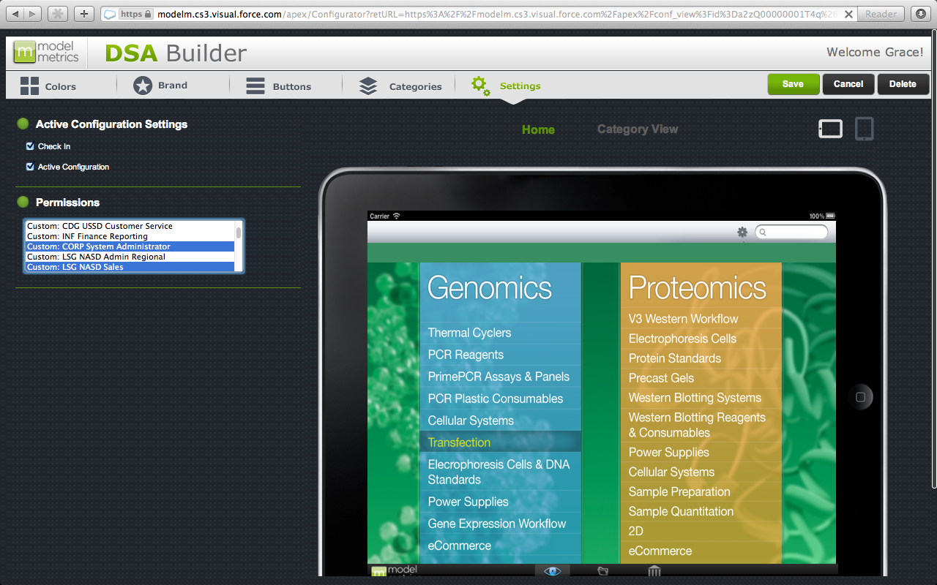
DSA Configuration: Settings Tab

Slide 21
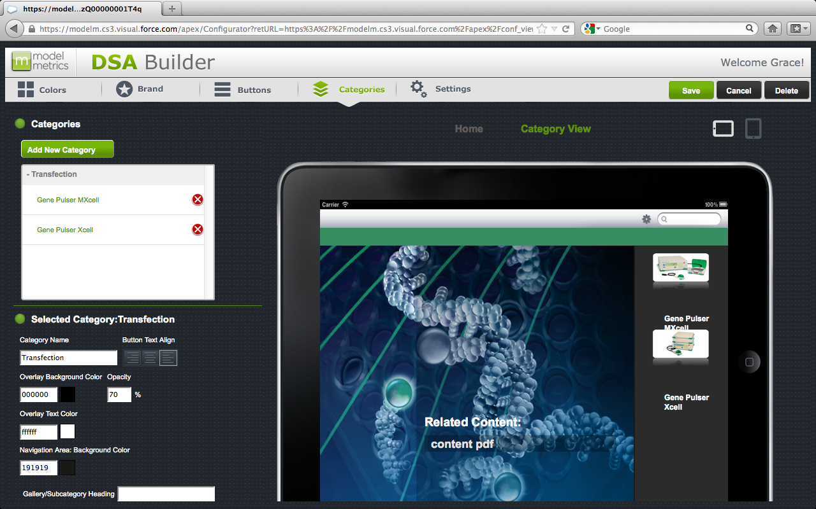
DSA Configuration: Category Tab

Slide 22
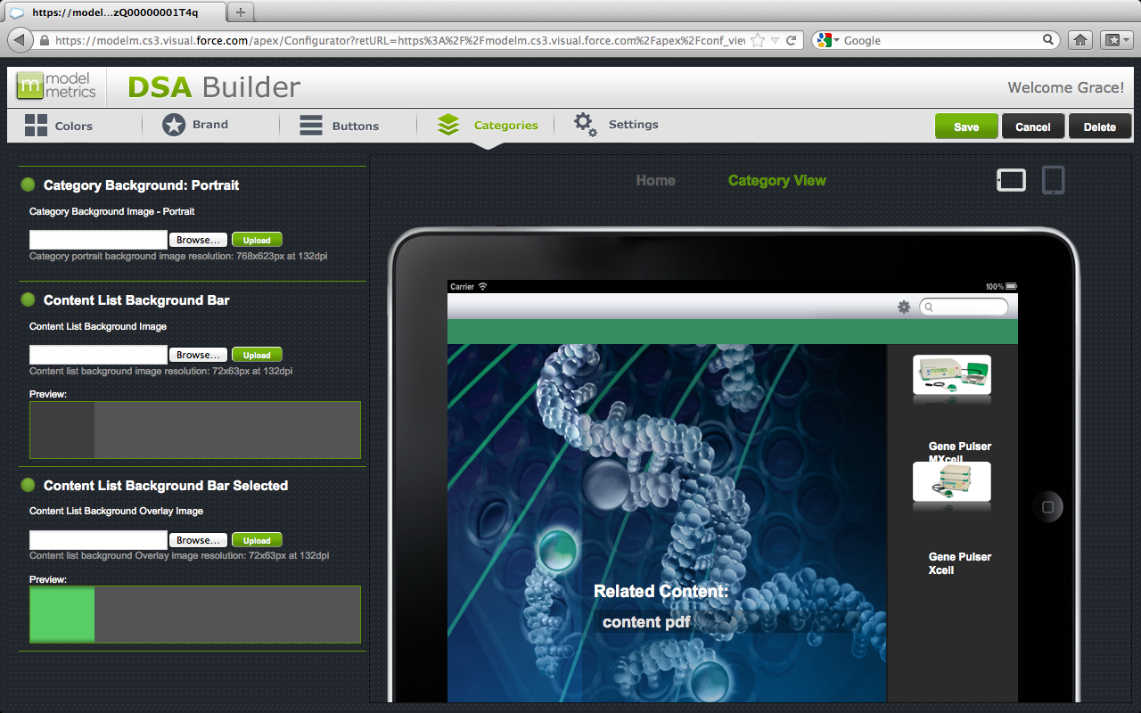
DSA Configuration: Category Tab

Slide 23
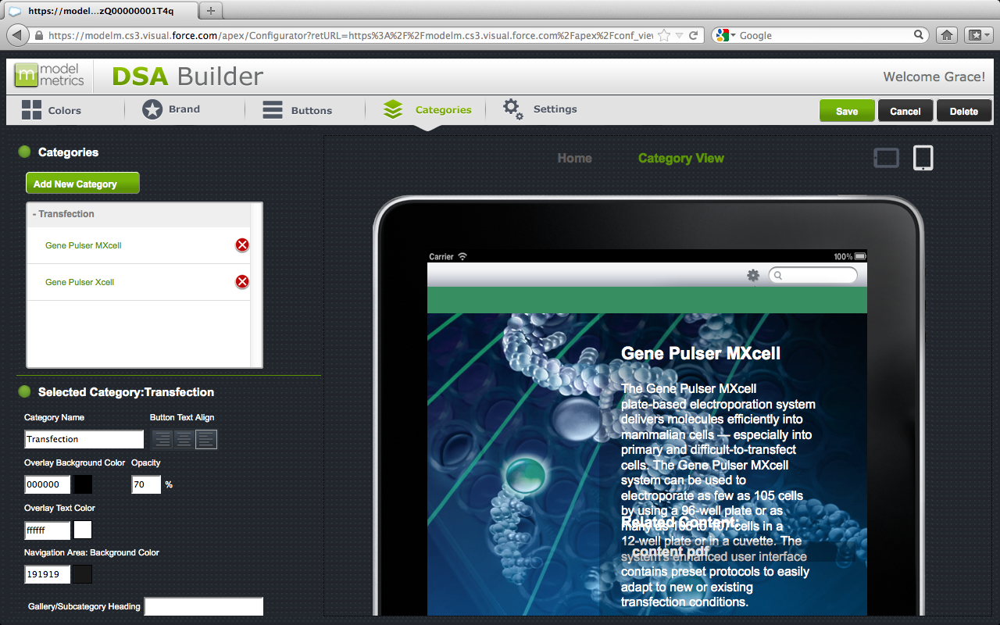
DSA Configuration: Category Tab

Slide 24
Thank You

